Slide 1


Slide 2

Department of Computer Science and Engineering
A Universal Approach expanding the diagnostic power of this model beyond skin cancer
PRESENTED BY
Bellamkonda Nanda Krishna
Kalva Adi Babu
Kurra Venkatesh
(21471A05L8)
(21471A05M8)
(21471A05N4)
Under the Guidance of,
Dr. S. V. N. Sreenivasu _{Mtech.,Phd.,}
Professor,
Department of Computer Science and Engineering,
Narasaraopeta Engineering College (Autonomous), Narasaraopet- 522 601.
Review No.01
Department of CSE

Slide 3
OUTLINE
Abstract
Introduction
Literature Survey
Research Gaps
Problem Statement
Objectives
Block Diagram / Flow Diagram
Methodology
Implementation
Results and Analysis
Conclusion & Future Scope
References
Question and Answers
Acknowledgements
Review No.01
Department of CSE

Slide 4
ABSTRACT
Artificial intelligence and deep learning algorithms have revolutionized skin cancer detection, improving survival and early diagnosis rates. This Project presents a multiframework approach to melanoma detection by combining Deep Convolutional Neural Networks (VGG19, VGG16, ResNet50), Capsule Networks (CapsNet), and Vision Transformers (ViT) for comprehensive feature extraction. These features are classified using an ensemble model that integrates five machine learning classifiers—Support Vector Classifier (SVC), XGBoost, Random Forest, K-Nearest Neighbors (KNN), and Logistic Regression—via majority voting. The ViT model achieved a remarkable accuracy of 92.4%, while the ensemble model demonstrated robust performance with an accuracy of 92.3%. This Project validates the superior efficacy of hybrid models in enhancing skin cancer detection accuracy.
Review No.01
Department of CSE

Slide 5
INTRODUCTION
Project Focus: Developing an advanced diagnostic system for melanoma detection using a hybrid deep learning and machine learning approach.
Key Models Used: Combines Vision Transformers (ViT), CNNs (VGG16, VGG19, ResNet50), Capsule Networks (CapsNet), and ensemble machine learning classifiers.
Objective: To enhance accuracy and reliability in detecting melanoma by leveraging the strengths of multiple models and techniques.
Significance: Addresses limitations of traditional diagnostic methods by offering a faster, more precise, and scalable solution suitable for real-world medical applications.
Review No.01
Department of CSE

Slide 6
INTRODUCTION
Motivation behind the Project:
Rising Health Concern: Melanoma is among the most aggressive and fatal skin cancers, requiring early and accurate detection to improve survival rates.
Limitations of Traditional Methods: Diagnostic approaches such as imaging, observation, and biopsy are time-consuming, invasive, and prone to human error.
Advancements in AI and ML: Artificial intelligence (AI) and deep learning offer significant potential to revolutionize medical diagnostics by providing fast, accurate, and non-invasive solutions.
Need for Hybrid Solutions:
Existing models often focus on single frameworks, limiting their robustness and generalizability.
A hybrid approach integrating multiple models can overcome individual model limitations and improve diagnostic reliability.
Review No.01
Department of CSE

Slide 7
INTRODUCTION
Importance
Improved Diagnostic Accuracy: Deep learning models have demonstrated superior performance in identifying melanoma compared to traditional methods.
Enhanced Healthcare Outcomes: Early and precise detection significantly improves survival rates and reduces treatment costs.
Relevance
AI in Medical Diagnostics: The integration of Vision Transformers (ViT) and ensemble learning enhances model reliability and adaptability in clinical settings.
Scalability: The proposed system can be extended to other medical imaging tasks, making it a valuable tool in healthcare.
Bridging Gaps: Addresses limitations of existing single-model frameworks by combining deep and machine learning techniques for better performance.
Review No.01
Department of CSE

Slide 8
LITERATURE SURVEY
No | Title | Author | Methodology Adapted | Key Findings | Gaps
1 | Enhancement in Skin Cancer Detection using Image Super Resolution and Convolutional Neural Network | Ashutosh Lembhe, Pranav Motarwar, Rudra Patil, Susan Elias | Utilizes Image Super Resolution (ISR) and CNN models (ResNet, VGGNet) for classification of skin lesion images. | ISR improved skin cancer detection accuracy; supports early diagnosis effectively. | Limited scalability in real-time diagnostic environments; needs further validation with diverse dataset
2 | A Comparative Study of Deep Learning Architectures on Melanoma Detection | Sara Hosseinzadeh Kassani, Peyman Hosseinzadeh Kassani | Comparative evaluation of deep learning models (AlexNet, VGGNet, ResNet, Xception); employs data augmentation techniques. | ResNet50 performed best with 92% accuracy; augmentation improved results. | Dependence on pre-trained models; limited focus on computational efficiency for clinical application.
3 | Melanoma Skin Cancer Detection Using Ensemble of Machine Learning Models Considering Deep Feature Embeddings | Subhayu Ghosh, Sandipan Dhar, Raktim Yoddha, Shivam Kumar, Abhinav Kumar Thakur, Nanda Dulal Jana | The study employs an ensemble of machine learning models that utilize deep feature embeddings to detect melanoma skin cancer. This approach combines multiple models to improve detection accuracy. | The ensemble method, leveraging deep features, enhances the accuracy of melanoma detection compared to individual models. This suggests that combining multiple models can lead to better diagnostic performance. | The study may not have addressed the computational complexity associated with ensemble methods, and the generalizability of the findings to diverse populations or datasets might require further validation.
Review No.01
Department of CSE

Slide 9
LITERATURE SURVEY
No | Title | Author | Methodology Adapted | Key Findings | Gaps
4 | Melanoma Skin Cancer Detection Using Deep Learning and Classical Machine Learning Techniques: A Hybrid Approach | Jinen Daghrir, Lotfi Tlig, Moez Bouchouicha, Mounir Sayadi | Combines CNNs with SVM and KNN. Features like texture, borders, and color are merged using majority voting. | Combined methods improved accuracy to 88.4%. CNN alone achieved 85.5% accuracy. | Limited data used; didn’t explore anomaly detection features like comparing with surrounding moles.
5 | DermaDL: Advanced Convolutional Neural Networks for Automated Melanoma Detection | Jose F Rodrigues-Jr, Bruno Brandoli, Sihem Amer-Yahia | Designed a new CNN model with features like Aggregated Transformations and Squeeze-and-Excite blocks. | Achieved 90.5% sensitivity and competitive accuracy with fewer model weights than standard architectures. | Performance dropped when tested on unrelated datasets. Suggested standardizing image collection processes.
6 | Melanoma Disease Detection Using Convolutional Neural Networks | Ravva Sai Sanketh, Dr. M Madhu Bala, Panati Viswa Narendra Reddy, G V S Phani Kumar | Used CNNs with local and global texture analysis for classifying skin lesions into benign or malignant. | Reported high accuracy and reliability compared to manual methods. | Tested only on a single dataset (ISIC); needs validation with more diverse data.
Review No.01
Department of CSE

Slide 10
LITERATURE SURVEY
No | Title | Author | Methodology Adapted | Key Findings | Gaps
7 | A Deep Learning Model Integrating FrCN and Residual Convolutional Networks for Skin Lesion Segmentation and Classification | Mohammed A. Al-masni et al. | Combined Full Resolution Convolutional Network (FrCN) for segmentation and ResNet-50 for classification. | Achieved 94.03% accuracy in segmentation and 81.57% in classification using ISIC 2017 dataset. | Challenges in handling low-contrast and complex skin lesions.
8 | Automated Deep Learning Based Melanoma Detection and Classification Using Biomedical Dermoscopic Images | Amani Abdulrahman Albraikan et al. | Used k-means clustering for segmentation, Capsule Network (CapsNet) for feature extraction, and CSO for classification. | Effective classification with improved accuracy and balanced performance on dermoscopic image datasets. | High computational cost; sensitivity to noisy and low-resolution images.
9 | Melanoma Diagnosis Using Deep Learning Techniques on Dermatoscopic Images | Mario Fernando Jojoa Acosta et al. | Mask R-CNN for ROI extraction and ResNet152 for classification, with data augmentation to handle imbalance. | Improved sensitivity and specificity (both > 80%) for melanoma detection in ISIC 2017 challenge dataset. | Limited dataset size for training; imbalance in benign and malignant classes.
10 | Skin Cancer Detection Using Deep Learning | C. Kavitha et al. | Used convolutional neural networks (CNNs) and ResNet50 models; pre-processed images | Improved classification accuracy to 89.03% with ResNet50 for skin cancer detection and classification across nine types | Limited dataset size; higher variety of images needed; patient demographics not considered
Review No.01
Department of CSE

Slide 11
LITERATURE SURVEY
5 papers related to Objectives
"A Comparative Study of Deep Learning Architectures on Melanoma Detection" (2019)- Evaluates deep learning models for accurate melanoma classification.
"A Deep Learning Model Integrating FrCN and Residual Convolutional Networks” (2019)- Combines segmentation and classification to enhance skin lesion detection.
"Melanoma Skin Cancer Detection Using Ensemble of Machine Learning Models" (2024)-Develops an ensemble approach integrating deep and machine learning for reliable melanoma detection
"DermaDL: Advanced CNNs for Automated Melanoma Detection" (2020)- Introduces a specialized CNN for efficient and precise melanoma detection.
“Melanoma Skin Cancer Detection Using Hybrid Deep and Classical Techniques" (2020)- Integrates CNN and classical models (SVM, KNN) for better diagnostic accuracy.
Review No.01
Department of CSE

Slide 12
LITERATURE SURVEY
Relevant Literature Summary
Techniques Used:
Datasets:
Applications:
Deep learning models like CNN, ResNet50, CapsNet, and Vision Transformers (ViT).
Hybrid approaches combining CNNs with classical models (SVM, KNN) and ensemble methods (e.g., majority voting).
Image processing techniques such as segmentation and feature extraction.
Public datasets like ISIC and Kaggle melanoma datasets.
Challenges noted in data diversity and the need for high-quality dermoscopic images.
Focus on melanoma detection and classification of skin lesions.
Highlighted potential for scalable diagnostic systems in real-world clinical settings.
Review No.01
Department of CSE

Slide 13
LITERATURE SURVEY
Key Findings:
Effective Techniques: Hybrid techniques (CNNs, ViT, CapsNet) with machine learning improve detection accuracy
High Accuracy & Data Challenges : Models often achieve over 90% accuracy but face dataset diversity and scalability challenges.
Practicality: Real-world implementation remains limited.
Relation to Project:
Supports using hybrid methods for accurate melanoma detection.
Emphasizes robust data preprocessing, aligning with our objectives.
Highlights the need for scalable, real-time clinical solutions.
Review No.01
Department of CSE

Slide 14
RESEARCH GAPS
Limited Generalization of Single Models
Issue: Focus on standalone models limits robustness.
Solution: Combined multiple models (ViT, CNNs, CapsNet) for enhanced accuracy.
Issue: Limited dataset variety and preprocessing lead to overfitting.
Solution: Used Kaggle melanoma dataset with advanced preprocessing to ensure diversity.
Issue: Lack of scalability for clinical use.
Solution: Implemented an ensemble model optimized for real-time clinical integration.
Dataset Diversity and Preprocessing
Scalability and Real-World Implementation
Review No.01
Department of CSE

Slide 15
RESEARCH GAPS
Feature Extraction Limitations
Issue: Ineffective feature extraction causes errors.
Solution: Used ViT and CapsNet for comprehensive feature extraction.
Issue: Underutilization of ensemble methods.
Solution: Combined DL models with ML classifiers (SVM, XGBoost, KNN) for improved performance.
Ensemble Method Effectiveness
Review No.01
Batch No.DB1
Department of CSE

Slide 16
PROBLEM STATEMENT
The Challenge:
Key Issues:
Significance:
Accurate and early detection of melanoma remains a critical medical challenge. Traditional diagnostic methods are time-consuming, invasive, and prone to human error.
Lack of scalability and generalization in standalone diagnostic models.
Inefficient feature extraction, resulting in reduced diagnostic accuracy.
Limited dataset diversity, leading to overfitting and poor real-world applicability.
Addressing these gaps can save lives by enabling early intervention.
Developing a hybrid model combining advanced deep learning techniques and machine learning classifiers promises a faster, more reliable, and scalable diagnostic solution.
Review No.01
Department of CSE

Slide 17
OBJECTIVES
Develop a Robust Diagnostic System: Design a hybrid model combining deep learning and machine learning techniques to enhance melanoma detection accuracy.
Leverage Advanced Architectures: Utilize models like Vision Transformers (ViT), CNNs (VGG16, VGG19, ResNet50), and CapsNet for comprehensive feature extraction.
Enhance Model Reliability: Implement an ensemble approach integrating classifiers (e.g., SVC, XGBoost, Random Forest) for improved performance.
Ensure Real-World Applicability: Optimize the system for scalability and effectiveness in clinical settings by addressing dataset diversity and preprocessing challenges.
Review No.01
Department of CSE

Slide 18
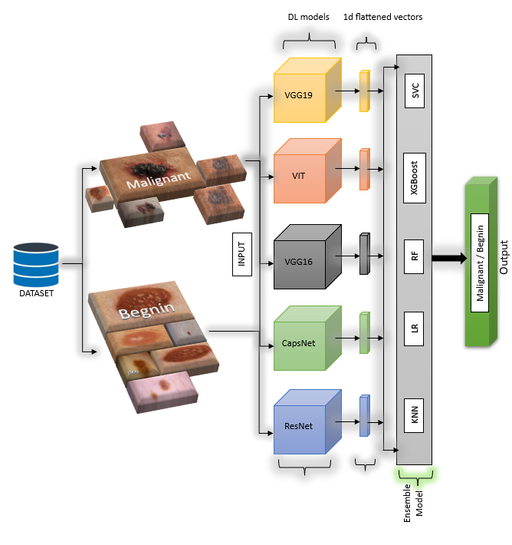
BLOCK DIAGRAM OR FLOW DIAGRAM
Melanoma skin cancer dataset of 10000 images
Review No.01
Batch No.DB1
Department of CSE

Slide 19
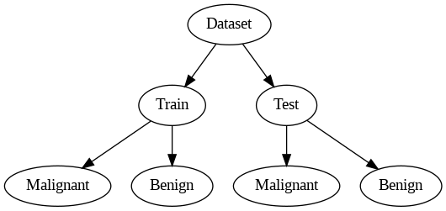
METHODOLOGY
Dataset Collection:
Sourced the "Melanoma Skin Cancer Dataset of 10,000 Images" from Kaggle.
Dataset includes 9,605 training images and 1,000 testing images, categorized as benign and malignant.
Review No.01
Department of CSE

Slide 20
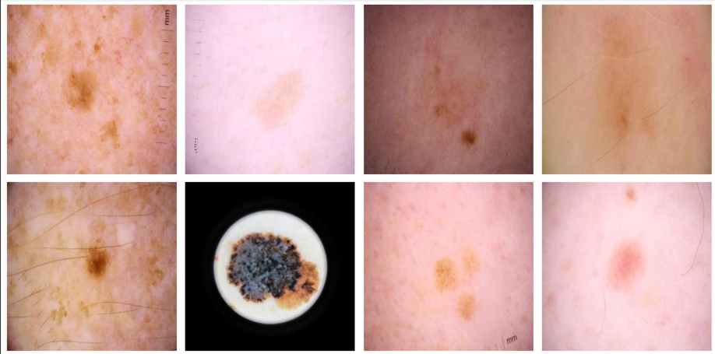
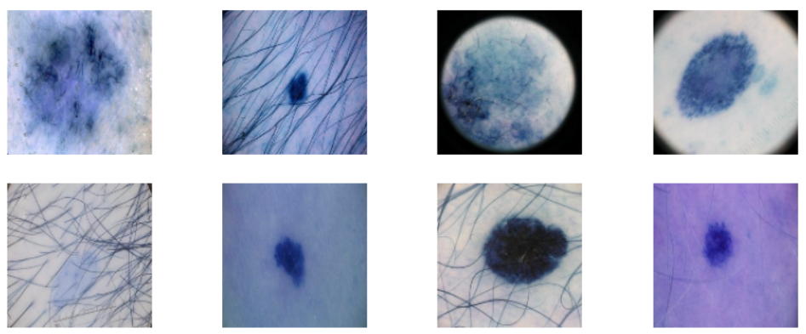
METHODOLOGY
Preprocessing:
Resizing: Images resized to 128x128 pixels for uniformity and reduced computational complexity.
Colorspace Conversion: Converted images from BGR to RGB format using OpenCV for compatibility with deep learning models.
Shuffling: Randomized image presentation to reduce bias and improve model generalization.
Normalization: Scaled pixel values to the range [0,1] for faster and consistent model training.
Label Encoding: Categorical labels ('benign', 'malignant') converted to numerical values (0, 1) for compatibility with machine learning algorithms.
Train-Test Split: Divided dataset into 80% training and 20% testing to ensure effective training and validation.
Images Before Conversion
Images After Conversion
Review No.01
Batch No.DB1
Department of CSE

Slide 21
METHODOLOGY
Feature Extraction using Deep Learning Models
1. VGG16 & VGG19
Purpose:
Consists of 16 and 19 layers, respectively, stacked in a sequential architecture.
Pre-trained Convolutional Neural Networks (CNNs) designed for hierarchical feature extraction.
Architecture:
Uses small 3×3 convolutional filters to extract low-level and high-level features from images.
Includes Max-Pooling Layers to downsample the feature maps while preserving essential information.
Fully connected layers at the end output a feature vector, which is used for classification.
Advantages:
Extracts texture and shape-related features critical for melanoma detection.
Deep architecture enables capturing complex patterns in dermoscopic images
Review No.01
Batch No.DB1
Department of CSE

Slide 22
METHODOLOGY
2. ResNet50 (Residual Network)
Purpose:
A deep CNN model with 50 layers, designed to overcome the vanishing gradient problem in deep networks
Architecture:
Uses skip connections (Residual Blocks) to allow gradients to flow smoothly, making training more efficient.
Enables better feature propagation across deep layers.
Extracts both local and global features from melanoma images.
Advantages:
Improved feature retention over very deep networks.
Better performance in classifying fine-grained details in skin lesions.
Review No.01
Batch No.DB1
Department of CSE

Slide 23
METHODOLOGY
3. Capsule Networks (CapsNet)
Purpose:
Introduces capsules, which are groups of neurons that capture spatial hierarchies in images.
Unlike CNNs, which discard positional relationships, CapsNet preserves these relationships.
Architecture:
Uses Dynamic Routing Algorithm to adjust feature weights based on spatial patterns.
Encodes part-whole relationships crucial for distinguishing between benign and malignant melanoma.
The Squash Activation Function ensures that output vectors are normalized for accurate representation.
Advantages:
Captures spatial hierarchies better than CNNs.
More robust to rotation and viewpoint changes, making it effective for medical imaging.
Review No.01
Batch No.DB1
Department of CSE

Slide 24
METHODOLOGY
4. Vision Transformer (ViT)
Purpose:
Utilizes self-attention mechanisms to capture long-range dependencies in images.
Unlike CNNs, ViT divides images into patches and processes them as a sequence.
Architecture:
Splits the image into 16×16 patches and embeds them into a lower-dimensional space.
Each patch passes through Multi-Head Self-Attention (MHSA) layers.
The output is a feature vector that represents the entire image holistically.
Advantages:
Captures global context better than CNNs.
Performs well even with limited training data, making it suitable for medical datasets.
Achieved highest accuracy (92.4%) in melanoma detection among all tested models.
Review No.01
Batch No.DB1
Department of CSE

Slide 25
METHODOLOGY
Classification Using Machine Learning Models
Logistic Regression – Simple & fast, good for linear separability.
Random Forest – Combines multiple trees, reduces overfitting, handles high-dimensional data.
K-Nearest Neighbors (KNN) – Distance-based, real-time learning, good for well-labeled datasets.
Support Vector Classifier (SVC) – Maximum margin hyperplane, works well in high-dimensional spaces.
XGBoost – Boosting algorithm, fast & great at complex patterns in medical data.
Ensemble Voting Classifier – Combines all models, balances bias & variance, best accuracy (92.3%).
Review No.01
Batch No.DB1
Department of CSE

Slide 26
METHODOLOGY
Feature Extraction Pipeline
Input Image (128×128×3)
Passes through Pre-Trained Models (VGG16, VGG19, ResNet50, CapsNet, ViT).
Feature Vectors Extracted (High-dimensional representations of melanoma images).
Concatenated and Passed to Machine Learning Classifiers (SVC, XGBoost, Random Forest, etc.).
Final Prediction using Ensemble Voting Classifier.
Training and Hyperparameter Optimization
Adam Optimizer with a learning rate of 0.0001.
Batch Size: 32 per epoch.
Regularization: L2 regularization with dropout (0.1) to prevent overfitting.
Review No.01
Batch No.DB1
Department of CSE

Slide 27
Advantages of the Proposed Methodology
1. High Accuracy & Robustness
Achieved 92.4% accuracy using Vision Transformer (ViT).
Ensemble model improves performance over individual models.
2. Hybrid Deep Learning & Machine Learning Approach
Combines CNNs, ViT, ResNet50, and CapsNet for feature extraction.
Uses Logistic Regression, Random Forest, XGBoost, SVC, and KNN for classification.
3. Efficient Feature Extraction
Deep learning models extract rich spatial & hierarchical features.
CapsNet maintains spatial relationships, improving melanoma detection.
4. Reduces Overfitting & Bias
Data augmentation techniques (flipping, rotation, zooming) enhance model generalization.
Majority voting in ensemble classifier balances model predictions.
5. Generalization Beyond Skin Cancer
The proposed model can be adapted for other medical image classification tasks.
Review No.01
Batch No.DB1
Department of CSE

Slide 28
IMPLEMENTATION
1. Hardware Requirements:
System Type : Intel\u00ae Core\u2122 i5 or higher, 64-bit processor
Cache memory : 6 MB or higher
RAM : Minimum 8GB (16GB recommended )
Hard Disk : 512 GB (SSD recommended for faster read/write )
2. Software Requirements:
Operating System : Windows 11, 64-bit Operating System
Coding Language : Python 3.8+
Python Libraries : TensorFlow, Keras, OpenCV, NumPy, Pandas, Matplotlib, Scikit-learn, XGBoost
Browser : Any Latest Browser like Chrome
Review No.01
Batch No.DB1
Department of CSE

Slide 29
Challenges 🛑 | Solutions Implemented ✅
1. Imbalanced Dataset (More benign images than malignant) | Data Augmentation (Rotation, Flipping, Zooming) to balance classes.
2. Overfitting Issue (Deep learning models learning noise) | Applied Dropout (0.1), L2 Regularization, and Early Stopping.
3. High Computational Cost (Deep learning models require high resources) | Used Google Colab (GPU) for training and optimized models with batch size tuning.
4. Difficulty in Capturing Spatial Features | Integrated CapsNet to preserve spatial relationships.
5. Long-Range Dependencies in Images | Implemented Vision Transformer (ViT) for global attention-based feature extraction.
6. Model Generalization for Other Diseases | Designed scalable architecture that can be adapted for other medical image classifications.
Review No.01
Batch No.DB1
Department of CSE

Slide 30
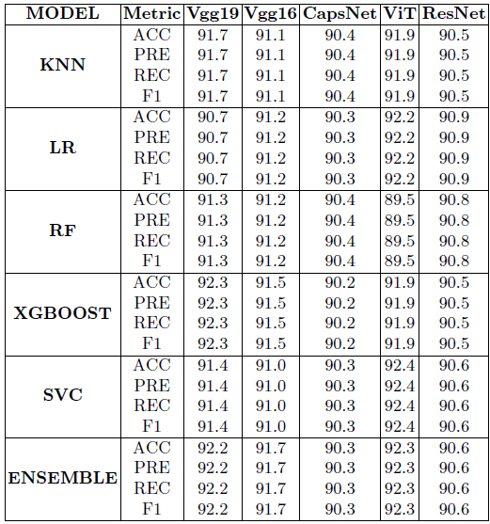
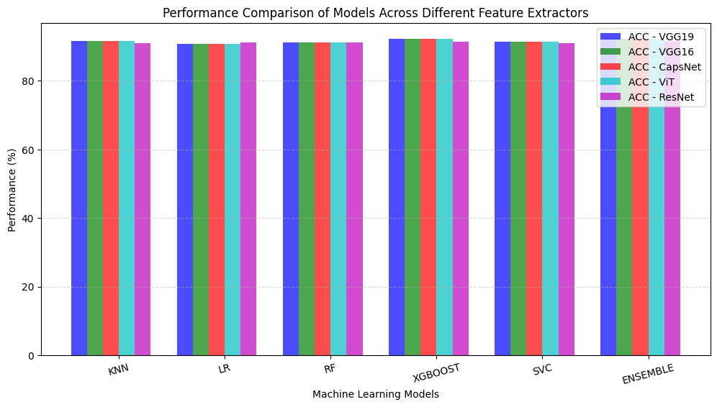
RESULTS & ANALYSIS
Fig 2 : Comparision of Model Architecture
Fig 1 : Comparison of Models Across Metrics
Review No.
Batch No.DB1
Department of CSE

Slide 31
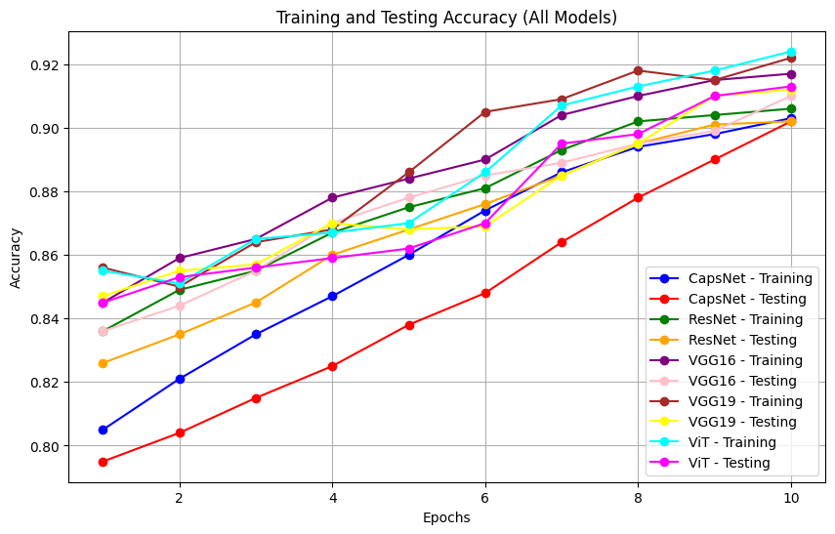
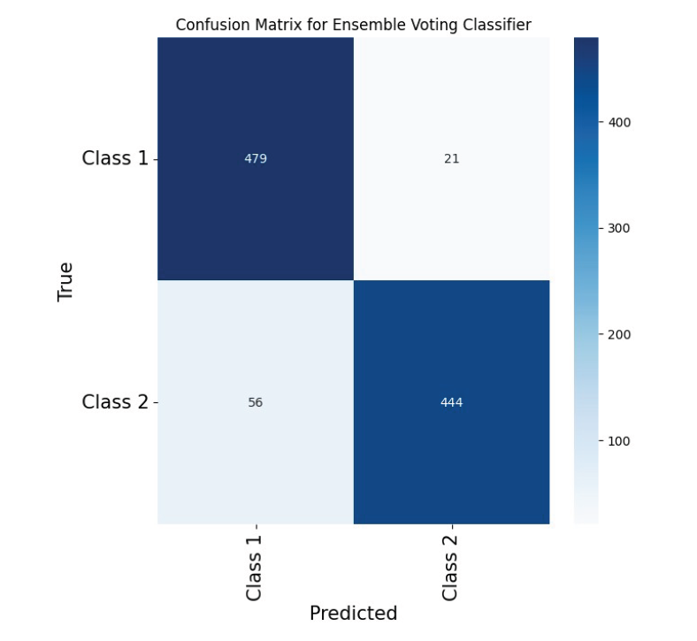
RESULTS & ANALYSIS
Fig 3:Training and Testing Accuracy
Fig 4:Confusion Matrix of Ensemble Model
Review No.
Batch No.DB1
Department of CSE

Slide 32
CONCLUSION and FUTURE SCOPE
Conclusion
Our project enhances melanoma detection using deep learning models (VGG19, VGG16, ResNet50, ViT, and CapsNet) combined with ML classifiers (XGBoost, SVC). ViT achieved the highest accuracy (92.4%), excelling in capturing global image features critical for melanoma detection. Its self-attention mechanism improved precision, recall, and F1 scores, ensuring reliable early diagnosis. An ensemble approach combining ViT with CNNs via majority voting further boosted robustness to 92.3%. This study highlights ViT’s potential in medical imaging, suggesting hybrid CNN-ViT models for improved diagnostics. Future research can adapt these methods to broader medical applications, fostering AI-driven clinical advancements.
Review No.
Batch No.DB1
Department of CSE

Slide 33
Future Scope
Expand Model Application: Adapt the architecture for diverse medical imaging tasks beyond skin cancer by identifying transferable features.
Evaluate in New Contexts: Test the model on various medical datasets to assess accuracy and generalizability.
Clinical Collaboration: Work with medical specialists to ensure seamless integration into workflows, addressing clinical needs effectively.
Review No.
Batch No.DB1
Department of CSE

Slide 34
Limitations
Data Constraints – Limited dataset size, class imbalance.
Computational Resources – High training time, GPU/TPU required.
Overfitting Risk – Requires careful tuning, risk of overfitting.
External Factors – Real-world data variations affect performance
Review No.
Batch No.DB1
Department of CSE

Slide 35
REFERENCES
[1] Kassani, S. H., & Kassani, P. H. (2019). A comparative study of deep learning architectures on melanoma detection. Tissue and Cell, 58, 76-83.
[2] Al-Masni, M. A., Al-Antari, M. A., Park, H. M., Park, N. H., & Kim, T. S. (2019, May). A deep learning model integrating FrCN and residual convolutional networks for skin lesion segmentation and classification. In 2019 IEEE Eurasia conference on biomedical engineering, healthcare and sustainability (ECBIOS) (pp. 95-98). IEEE.
[3] Albraikan, A. A., Nemri, N., Alkhonaini, M. A., Hilal, A. M., Yaseen, I., & Motwakel, A. (2023). Automated Deep Learning Based Melanoma Detection and Classification Using Biomedical Dermoscopic Images. Computers, Materials & Continua, 74(2).
[4] Jojoa Acosta, M. F., Caballero Tovar, L. Y., Garcia-Zapirain, M. B., & Percybrooks, W. S. (2021). Melanoma diagnosis using deep learning techniques on dermatoscopic images. BMC Medical Imaging, 21, 1-11.
[5] Daghrir, J., Tlig, L., Bouchouicha, M., & Sayadi, M. (2020, September). Melanoma skin cancer detection using deep learning and classical machine learning techniques: A hybrid approach. In 2020 5th international conference on advanced technologies for signal and image processing (ATSIP) (pp. 1-5). IEEE.
Review No.
Batch No.DB1
Department of CSE

Slide 36
REFERENCES
[6] Sanketh, R. S., Bala, M. M., Reddy, P. V. N., & Kumar, G. P. (2020, May). Melanoma disease detection using convolutional neural networks. In 2020 4th international conference on intelligent computing and control systems (ICICCS) (pp. 1031-1037). IEEE.
[7] Lembhe, A., Motarwar, P., Patil, R., & Elias, S. (2023). Enhancement in Skin Cancer Detection using Image Super Resolution and Convolutional Neural Network. Procedia Computer Science, 218, 164-173
[8] Rodrigues, J. F., Brandoli, B., & Amer-Yahia, S. (2020, July). DermaDL: advanced convolutional neural networks for automated melanoma detection. In 2020 IEEE 33rd International Symposium on Computer-Based Medical Systems (CBMS) (pp. 504-509). IEEE.
[9] Ghosh, S., Dhar, S., Yoddha, R., Kumar, S., Thakur, A. K., & Jana, N. D. (2024). Melanoma Skin Cancer Detection Using Ensemble of Machine Learning Models Considering Deep Feature Embeddings. Procedia Computer Science, 235, 3007-3015.
[10] Kavitha, C., Priyanka, S., Kumar, M. P., & Kusuma, V. (2024). Skin Cancer Detection and Classification using Deep Learning Techniques. Procedia Computer Science, 235, 2793-2802.
Review No.
Batch No.DB1
Department of CSE

Slide 37
REFERENCES
[11] Kadampur, M. A., & Al Riyaee, S. (2020). Skin cancer detection: Applying a deep learning based model driven architecture in the cloud for classifying dermal cell images. Informatics in Medicine Unlocked, 18, 100282.
[12] Dildar, M., Akram, S., Irfan, M., Khan, H. U., Ramzan, M., Mahmood, A. R., ... & Mahnashi, M. H. (2021). Skin cancer detection: a review using deep learning techniques. International journal of environmental research and public health, 18(10), 5479.
[13] Lee, V., Singh, G., Trasatti, J. P., Bjornsson, C., Xu, X., Tran, T. N., ... & Karande, P. (2014). Design and fabrication of human skin by three-dimensional bioprinting. Tissue Engineering Part C: Methods, 20(6), 473-484.
[14] Mehr, R. A., & Ameri, A. (2022). Skin cancer detection based on deep learning. Journal of biomedical physics & engineering, 12(6), 559.
[15] https://www.kaggle.com/datasets/hasnainjaved/melanoma-skin-cancer-dataset-of-10000-images
Review No.
Batch No.DB1
Department of CSE

Slide 38

QUESTIONS and ANSWERS
Review No.01
Department of CSE

Slide 39

ACKNOWLEGEMENTS
Presented By
B.Nanda krishna (21471A05L8)
K.Adi Babu (21471A05M8) S.Vasantha (21471A05N4)
Review No.01
Department of CSE

